Slide 1
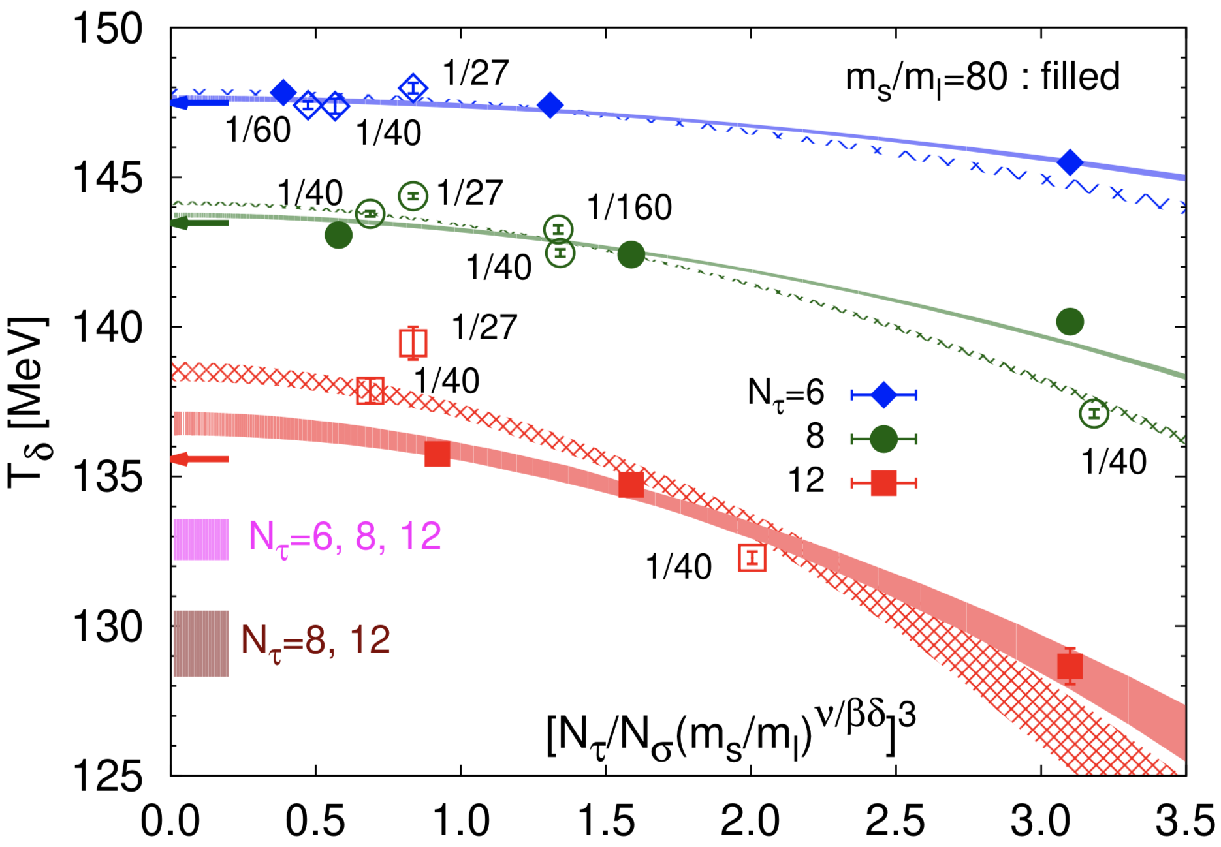

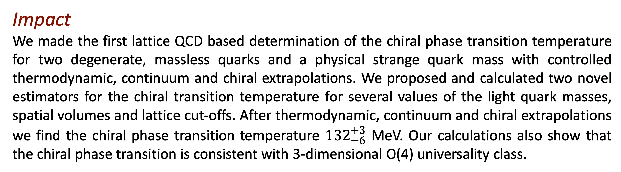
Chiral phase transition temperature of QCD
Science
For physical values of the light up, down and strange quark masses strongly interacting matter undergo a smooth crossover from a low temperature hadronic regime to a high temperature region that is best described by quark and gluon degrees of freedom. Nearly 40 years ago it was predicted that in the chiral limit--- when two (degenerate) light quark masses approach zero but the strange quark mass is kept fixed to its physical value--- this crossover behavior is expected to give rise to a ‘true’ chiral phase transition. Whether this chiral phase transition is first or second order may depend crucially on the temperature dependence of the chiral anomaly. In the latter case, critical behavior generally is expected to be controlled by the 3-dimensional O(4) universality class. The value of the chiral phase temperature itself is not only a fundamental scale of QCD, but also is expected to set an upper bound on the temperature at which a possible critical point at non-zero baryon chemical potential may appear. Thus, a reliable QCD based knowledge of the chiral transition temperature might have significant effect on the search for the QCD critical point in the Beam Energy Scan program at RHIC.
Impact
We made the first lattice QCD based determination of the chiral phase transition temperature for two degenerate, massless quarks and a physical strange quark mass with controlled thermodynamic, continuum and chiral extrapolations. We proposed and calculated two novel estimators for the chiral transition temperature for several values of the light quark masses, spatial volumes and lattice cut-offs. After thermodynamic, continuum and chiral extrapolations we find the chiral phase transition temperature ${132}_{−6}^{+3}$ MeV. Our calculations also show that the chiral phase transition is consistent with 3-dimensional O(4) universality class.
Light quark mass, spatial volume and lattice cut-off dependence of the chiral phase transition temperature of QCD.
Publication
HotQCD: arXiv:1903.04801

